Slide 1
DAY 5 · Session 1
Evidence package synthesis
Build an AI evidence package from prior workshop results
Applied AI Design Workshop for Faculty
Fred Livingston (fjliving@ncsu.edu) 2026
1

Slide 2
APPLIED AI DESIGN WORKSHOP
Session 1
Purpose: convert prior work into AI-ready evidence
What participants already created
What AI needs to stay grounded
Problem statements
Regression or classification metrics
Baseline comparisons
Data-preparation decisions
Feature-engineering rationale
Cluster profiles or PCA views
Clear source context
Metrics and visuals
Known limitations
Definitions of inputs and targets
Boundaries on claims
Human review criteria
3

Slide 3
APPLIED AI DESIGN WORKSHOP
Session 1
Activity: purpose and outputs
Convert prior ML work into a concise evidence package that an AI system can use without inventing claims.
Day 3–4 evidence
Model result
Limitations
Grounded prompt
AI response
Completed package should answer:
What evidence do we have?
What does it support?
What does it not support?
How should an AI system use it?
2

Slide 4
APPLIED AI DESIGN WORKSHOP
Session 1
Evidence package template
Problem
Dataset
Model or method
Metric/result
Visualization/table
Limitations
Human decision
Keep this packet concise: the AI system should use it as grounding context, not as a replacement for disciplinary judgment.
5

Slide 5
APPLIED AI DESIGN WORKSHOP
Session 1
Guided scenario: predicting defective process runs
A faculty research group wants to determine whether process measurements can help identify manufacturing runs likely to produce a defect.
Element
Guided example
Intended user
Process engineer or laboratory researcher
Decision
Flag runs for additional inspection
Unit
One manufacturing process run
Target
Defect vs. acceptable
Model role
Decision support, not automatic approval
Key framing question: what decision would change if the evidence were reliable?
3

Slide 6
APPLIED AI DESIGN WORKSHOP
Session 1
Step 1: state the problem precisely
Can process temperature, pressure, speed, and vibration be used to predict whether a manufacturing run will produce a defective part?
Field
Entry
Inputs
Temperature, pressure, speed, vibration
Target
0 = acceptable; 1 = defective
Task
Binary classification
Metric priority
Recall if missed defects are costly
4

Slide 7
APPLIED AI DESIGN WORKSHOP
Session 1
Step 2: describe the dataset and class balance
Total process runs
Acceptable runs
Defective runs
Initial concern
220
176
44
Imbalance
rows / observations
80% of dataset
20% of dataset
accuracy may mislead
Variable
Meaning
temperature_c
Process temperature in degrees Celsius
pressure_kpa
Process pressure in kilopascals
speed_mm_s
Process speed in millimeters per second
vibration_mm_s
Measured vibration in millimeters per second
defect
Binary quality outcome
A majority-class model can appear accurate while detecting no defects.
5

Slide 8
APPLIED AI DESIGN WORKSHOP
Session 1
Step 3: establish the baseline
Baseline rule: predict every process run as acceptable.
Baseline accuracy
Baseline defect recall
0.800
0.000
correct mostly because defects are rare
misses every defect
Interpretation
Accuracy alone is not adequate for this problem.
The baseline clarifies the minimum value a model must exceed.
Defect recall is essential if missed defects are expensive.
6

Slide 9
APPLIED AI DESIGN WORKSHOP
Session 1
Step 4: summarize the trained model
Model: standardized logistic-regression classifier
Data split: 75% training / 25% test · stratified · fixed random state
Metric
Result
Predicted acceptable
Predicted defect
Accuracy
0.855
Actual acceptable
44
0
Precision
1.000
Actual defect
8
3
Recall
0.273
F1 score
0.429
The model produces few false alarms, but misses most actual defects.
7

Slide 10
APPLIED AI DESIGN WORKSHOP
Session 1
Step 5: interpret the evidence
What the model did well
What the model did poorly
Improved accuracy from 0.800 to 0.855.
Every predicted defect was actually defective.
Produced no false alarms in the test set.
Detected only 3 of 11 defective runs.
Missed 8 defective runs.
Defect recall was only about 27%.
Practical meaning: the model is conservative and should not be used as the sole quality-control mechanism.
8

Slide 11
APPLIED AI DESIGN WORKSHOP
Session 1
Step 6: document limitations and next step
Limitations to report
Recommended next step
Only 220 observations.
Only four process variables.
One train/test split.
No external or prospective validation.
Associations do not prove causes.
Evaluate lower decision thresholds.
Test class weighting.
Collect more defective-run examples.
Examine errors by machine, material, or operating condition.
Use cross-validation before drawing stronger conclusions.
Rule of thumb: limitations are part of the evidence package
9

Slide 12
APPLIED AI DESIGN WORKSHOP
Session 1
Step 7: completed AI evidence package
Field
Example entry
Problem
Predict whether a process run will produce a defect
Inputs
Temperature, pressure, speed, vibration
Baseline
Majority-class prediction: accuracy 0.800; recall 0.000
Model
Standardized logistic regression
Result
Accuracy 0.855; precision 1.000; recall 0.273; F1 0.429
Boundary
Does not prove process variables cause defects
Next step
Adjust threshold, test class weighting, collect more defect data
10

Slide 13
APPLIED AI DESIGN WORKSHOP
Session 1
Step 8: prepare the evidence for an LLM
You are assisting a process engineer. Use only the evidence provided below.
Do not invent causes, variables, or performance results.
Evidence:
- Dataset: 220 process runs; 20% defective.
- Inputs: temperature, pressure, speed, vibration.
- Baseline: accuracy 0.800; defect recall 0.000.
- Logistic regression: accuracy 0.855, precision 1.000, recall 0.273, F1 0.429.
- Confusion matrix: TN=44, FP=0, FN=8, TP=3.
- Limitations: small dataset, single split, limited inputs, no external validation.
Produce: technical interpretation, manager summary, next analysis, and one unsupported claim.
Prompt pattern: role + evidence + constraints + requested structure.
11

Slide 14
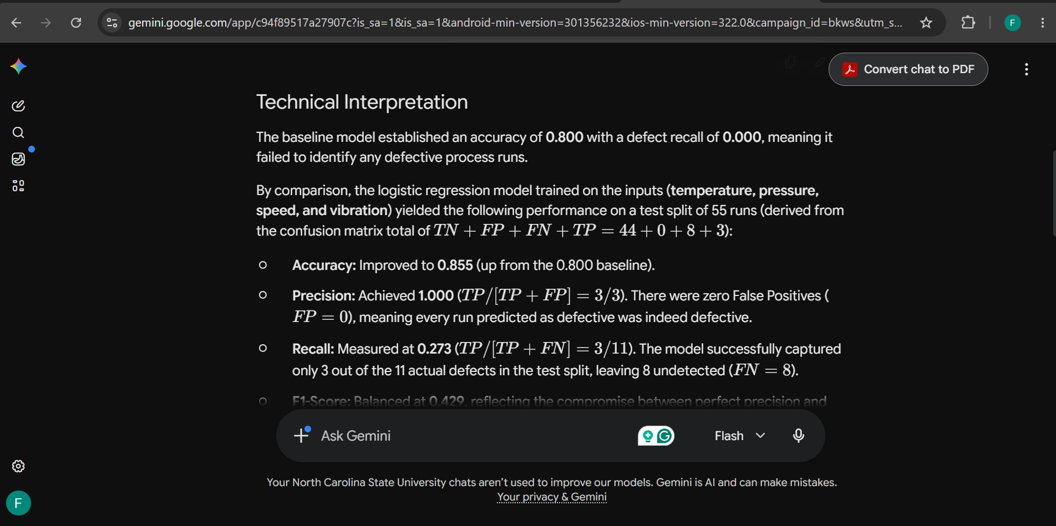
APPLIED AI DESIGN WORKSHOP
Session 1
Step 8: prepare the evidence for an LLM
https://gemini.google.com/
Prompt pattern: role + evidence + constraints + requested structure.
11

Slide 15
APPLIED AI DESIGN WORKSHOP
Session 1
Grounded Response Structure
Section
Content
Technical interpretation
Model improves accuracy but has low defect recall; screening value is limited.
Manager summary
Few false alarms, but only about one-quarter of defects detected. Do not replace inspection.
Recommended next analysis
Evaluate precision–recall tradeoffs across probability thresholds.
Unsupported statement
Do not claim that measured variables cause defects.
The AI explanation should organize evidence — not create new evidence.
12

Slide 16
APPLIED AI DESIGN WORKSHOP
Session 1
Compare AI responses: fluent vs evidence-based
Use the comparison to teach AI auditing.
⚠️ Ungrounded response
✓ Grounded response
May sound confident but can invent causes, prescribe corrective actions, and ignore low recall.
Should cite the supplied metrics, state limitations, avoid causal claims, and recommend a defensible next analysis.
Audit question
What to look for
Evidence
Does every number match the supplied metrics?
Interpretation
Does it distinguish association from causation?
Limitations
Does it mention low recall and lack of external validation?
Action
Is the recommendation consistent with the evidence?
9

Slide 17
APPLIED AI DESIGN WORKSHOP
Session 1
Transition to AI: predictive evidence becomes context
Data → Baseline → Model → Metrics → Interpretation → LLM/RAG workflow → Human review
The model does not become the full AI system.
The LLM should explain evidence, not invent evidence.
The human should decide whether the explanation is acceptable.
6

Slide 18
APPLIED AI DESIGN WORKSHOP
Session 1
Closing message
Evidence-grounded AI is a workflow design problem.
Do not ask:
“Can AI explain this?”
Ask instead:
“What evidence can AI use, and what must it not claim?”
Then design:
Grounding • limits • review • evaluation
13

